Slide 1

Data Science
Early Classification of Diabetes

Slide 2
Introduction
Problem Description
diabetes is one of the chronic, life-threatening diseases with the greatest rate of growth
Early identification of diabetes is usually preferred due to the existence of a relatively long asymptomatic period
This dataset includes 520 observations with 17 characteristics that were gathered from patients at the Sylhet Diabetes Hospital in Sylhet, Bangladesh

Slide 3
Introduction
Objective
• Create a classification model to predict diabetes.
• Interpret the results of the analysis and provide recommendations for healthcare providers based on the insights gained.
• Examine the most prevalent characteristics linked to diabetes risk.
• Perform data pre-processing tasks such as handling missing data, dealing with outliers, and scaling or normalizing the data

Slide 4
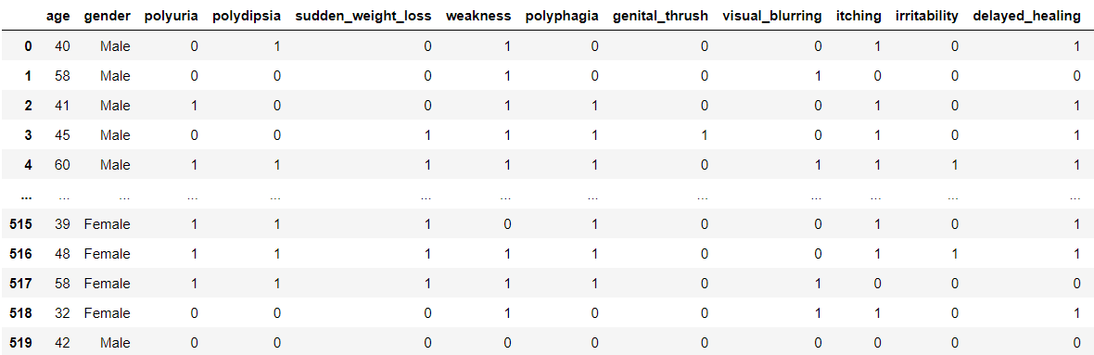
Phase 1
Data Preparation
An example of our data

Slide 5
Phase 1
Data Preparation
Checking any negative value to make it 0 or 1
Checking Nan values
Checking unique values

Slide 6
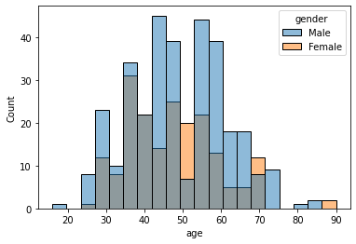
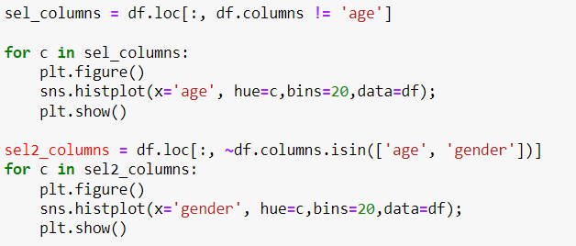
Model Planning
Visualization
since the data is categorical, histograms are drawn for each pair of variables, such as :-

Slide 7
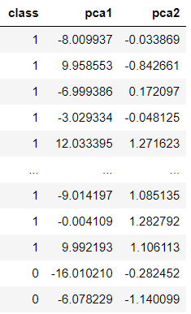
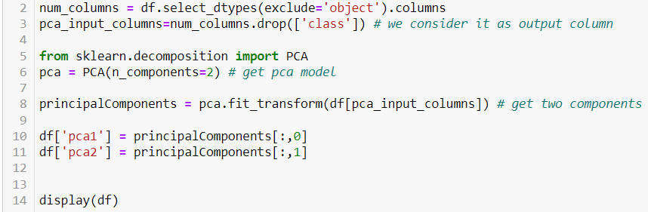
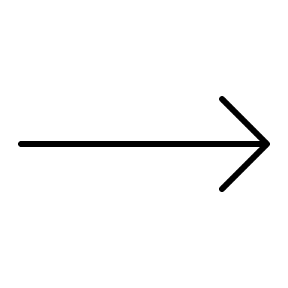
Model Planning
Finding PCA :
The variance captured by PCA 1 is: 98.02%
The variance captured by PCA 2 is: 0.50%
PCA 1 suggests that it contains valuable information and plays a crucial role in explaining the patterns or structure of the data.

Slide 8
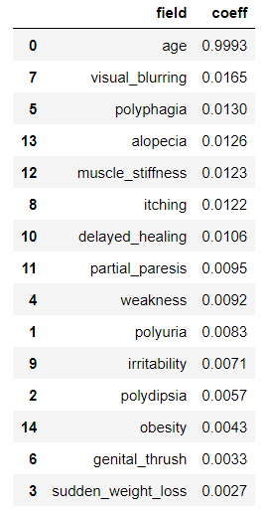
Model Planning
Coefficients of the linear combination for PCA 1:-

Slide 9
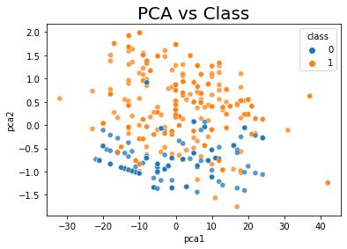
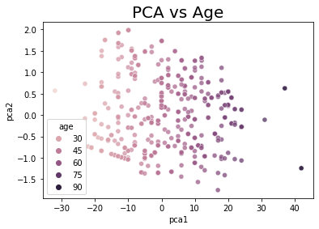
Model Planning
Visualization
Scatter plots for PCAs show the relations with Age & Class

Slide 10
Model Planning
Summery
To determine whether a specific dataset is best suited for classification using PCA and correlation, we need to consider several factors.
determine whether the dependent variable in the dataset is categorical or binary. If the dependent variable is categorical or binary, then a classification model may be more appropriate.
We can use correlation to identify potential predictors of the dependent variable. Variables that are highly correlated with the dependent variable may be good candidates for inclusion in a predictive model.
After identifying potential predictors, we can use PCA to reduce the dimensionality of the dataset and identify the most important variables that contribute to the variation in the data. We would typically select the principal components that explain the majority of the variance in the data and use them as input features for the classification model.
As a result, Classification model will be a great choice

Slide 11
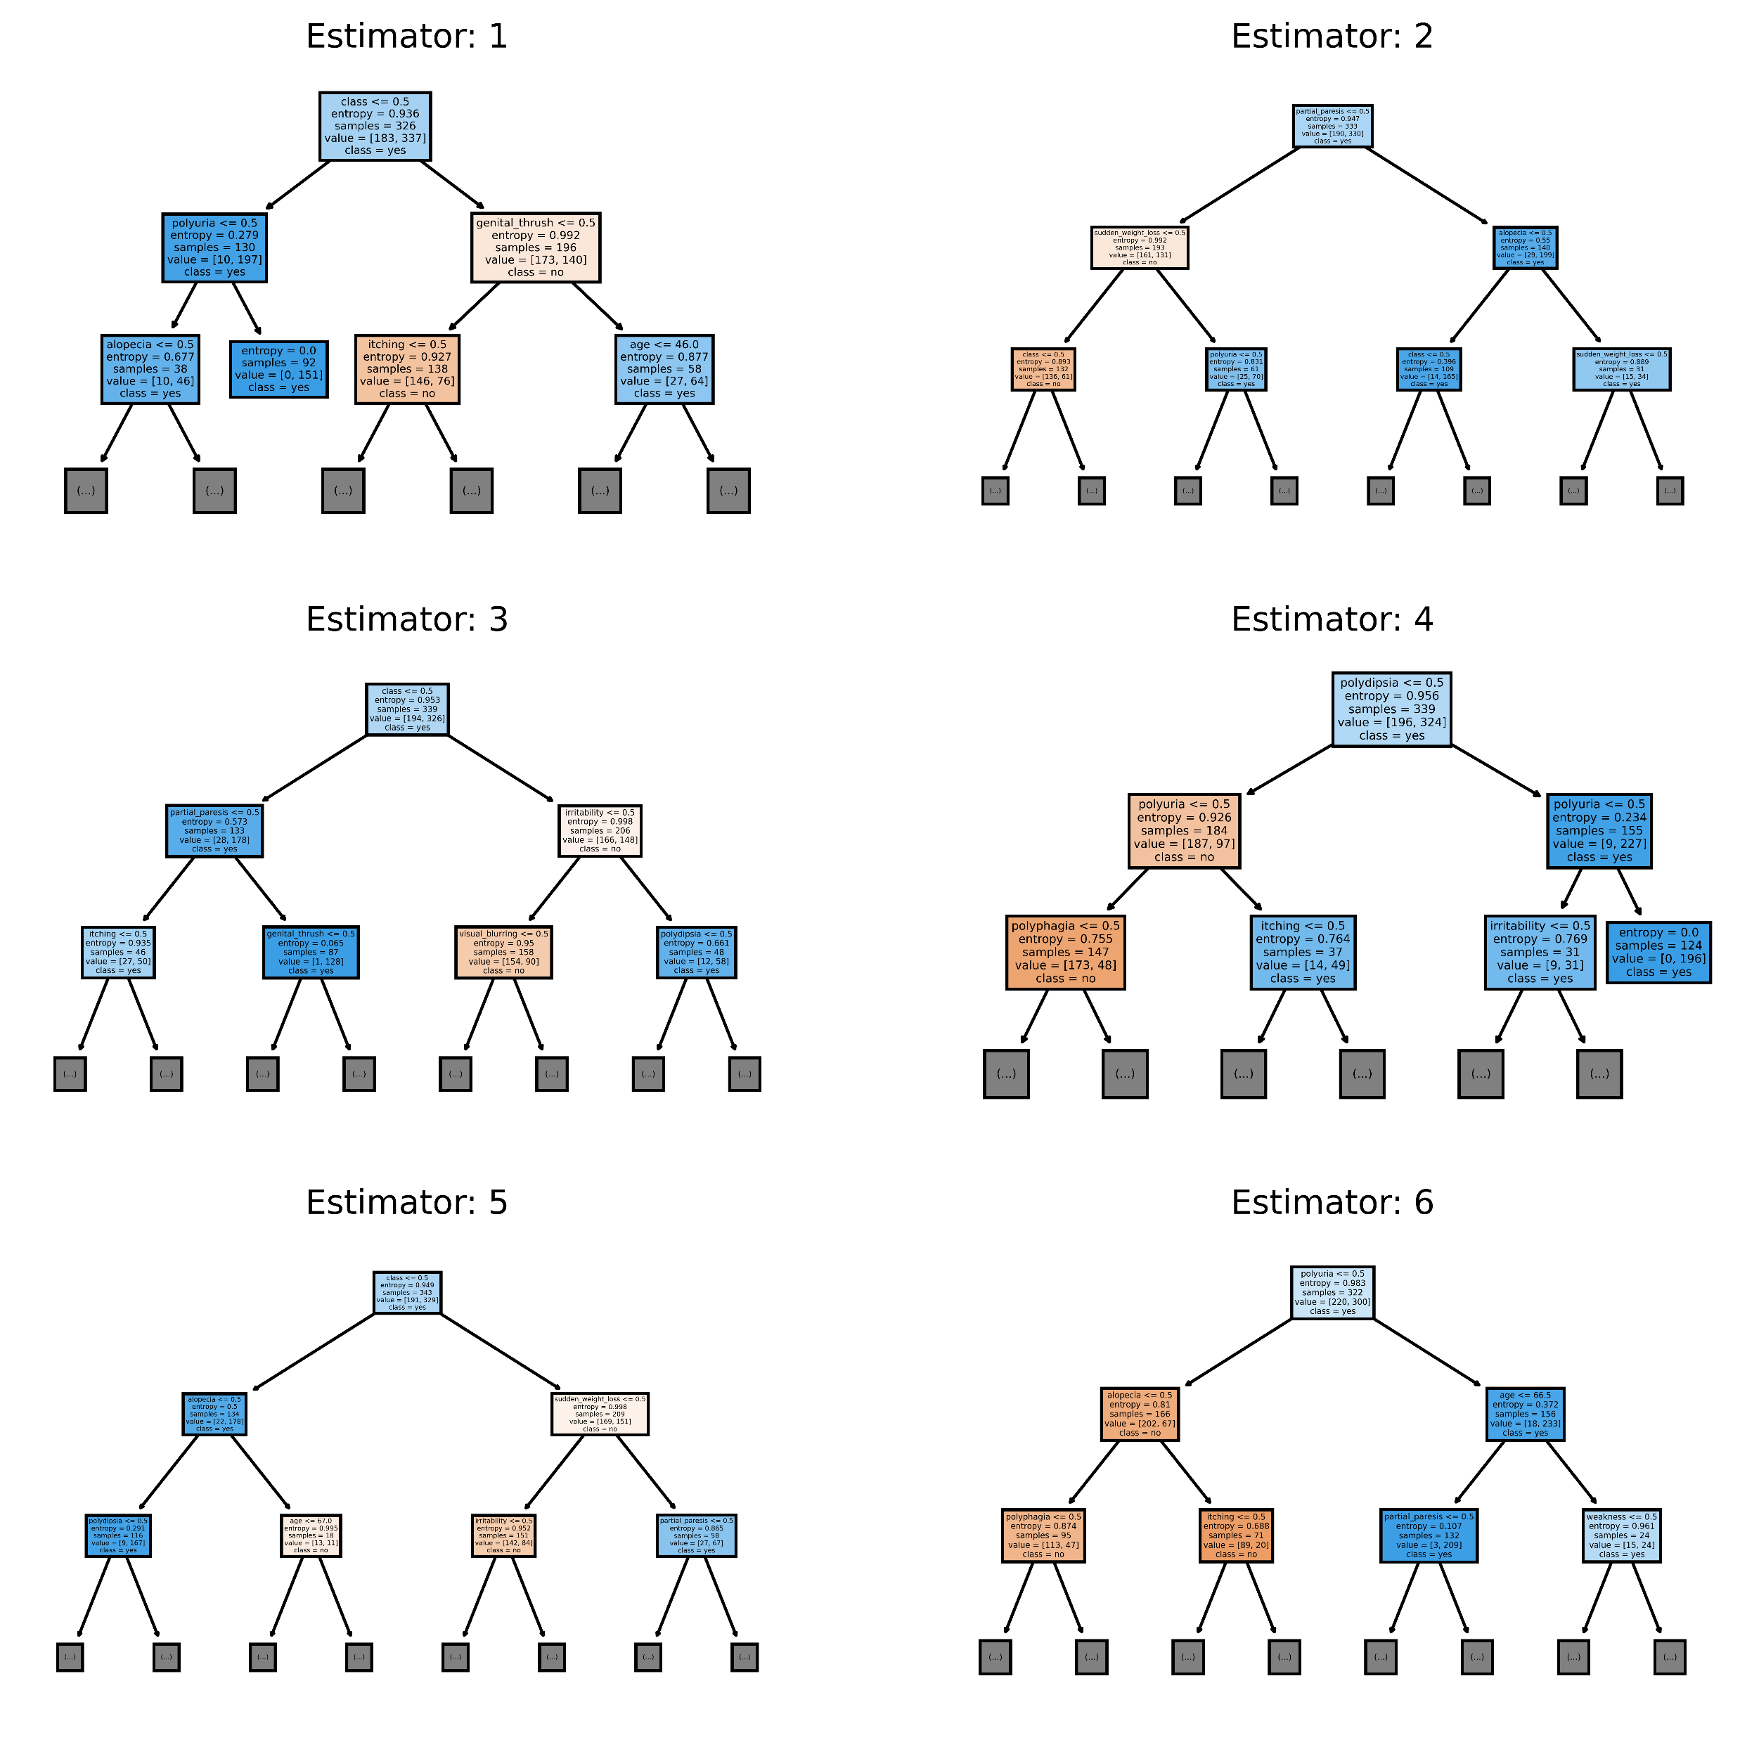
Model Building
Naive Bayes Classifier & Decision Tree
From the results, it can be seen that the Decision Tree performs better on the given data.

Slide 12
Model Building
Explanation
Comparison in the Accuracy using two different machine learning algorithms which are Naive Bayes Classifier & Decision Tree
The Accuracy of the Decision Tree is 98.4%
means that it correctly classified 98.4% of the instances in the dataset
The Accuracy of the Naïve Bayes Classifier is 87.1%
means that it correctly classified 87.1% of the instances in the dataset

Slide 13
Operationalize
General guidelines to adopt our methodology
Defining the use case and objectives
Defining the input and output data
Developing a deployment plan
Monitoring and evaluate performance
Documenting the process

Slide 14
Operationalize
List of the problems and issues in the implementation of the selected methodology
Data quality
Feature selection
Model interpretability
Patient privacy
Continuous monitoring and updating

Slide 15
Operationalize
Communicate results
Based on description and the boxplot, it appears that there is a correlation between age and the likelihood of having diabetes
The boxplots indicates that males tend to have a higher prevalence of diabetes compared to females.
The boxplot shows that for males, the values related to diabetes (polyuria, polydipsia, etc..) are generally higher than females.
This observation suggests that males in the dataset have more issues or symptoms associated with diabetes compared to females.

